Slide 1
CONTENTS
ABSTRACT
INTRODUCTION
OBJECTIVE
TECHNOLOGIES USED
RECOGNITION METHOD
PRE-PROCESSING
FEATURE EXTRACTION
APPLICATIONS

Slide 2
ABSTRACT
The project introduces an application using computer vision for hand gesture recognition. A snapshot or is taken as input with the help of webcam. Input is given to the system that will recognize hand gestures by using trained data.
Gesture recognition is a topic in computer science and language technology with the goal of interpreting human gesture via mathematical algorithms.
Gesture can originate from bodily motion or state but commonly from hand and face we will be focusing on hand gestures.
It will recognize static hand gestures.

Slide 3
INTRODUCTION
Hand gesture recognition system received great attention in the recent few years because of its manifoldness applications and the ability to interact with machine efficiently through human computer interaction.
Some recent reviews explained gesture recognition system applications and its growing importance in our life especially for Human computer Interaction HCI, Robot control, games, and surveillance, using different tools and algorithms.

Slide 4
PROJECT OBJECTIVE
The scope of this project is to recognize hand gestures and perform specified task.
High priority for the system is to be simple without use of any special hardware.
Gestures will be recognized using webcam.

Slide 5
TECHNOLOGIES USED
PYTHON
OPENCV
SUPERVISED LEARNING

Slide 6
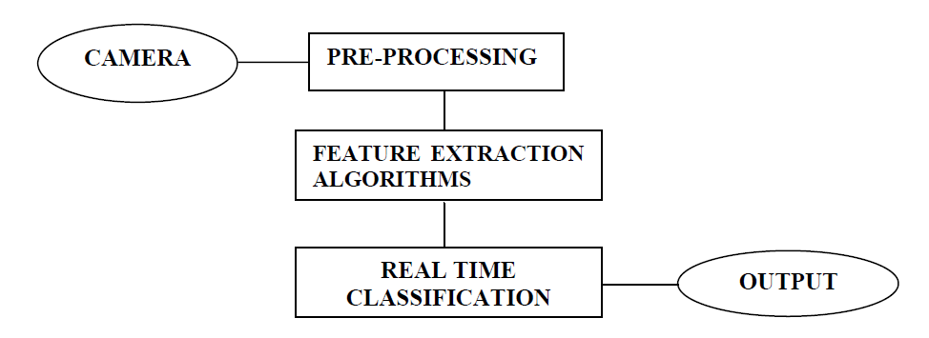
RECOGNITION METHOD
Hand gesture recognition system can be divide into following modules:
Preprocessing
Feature extraction of the processed image
Real time classification

Slide 7
PRE-PROCESSING
The preprocessing prepares the image sequence for the recognition , so before calculating the diagonal sum and other algorithms, pre-processing is performed to get the appropriate image.
Pre-processing consists of following tasks:
Skin modeling
Removal of background
Conversion from RGB to binary
Hand detection

Slide 8
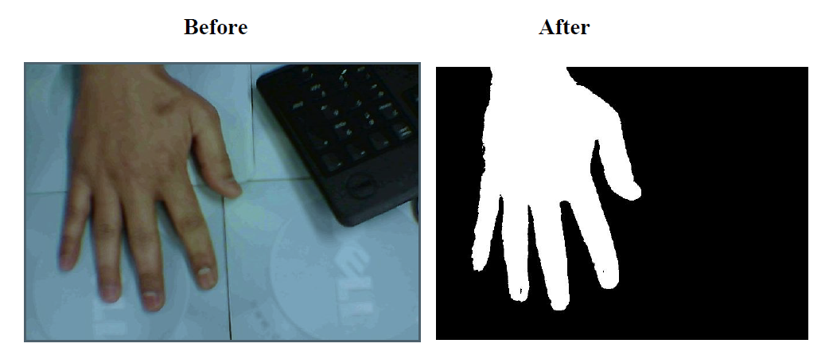

Slide 9
FEATURE EXTRACTION
Neural Networks
Row vector algorithm
Edging and row vector passing algorithm
Mean and standard deviation of edged image
Diagonal sum algorithm

Slide 10
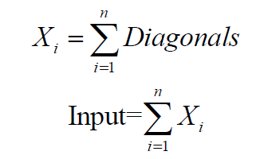
DIAGONAL SUM ALGORITHM
In the pre-processing phase, doing mentioned steps in the methodology, skin modeling removal of the background, conversion of RGB to binary and labeling. The binary image format also stores an image as matrix but can only color pixel black or white (and nothing ion between). It assigns as 0 for black and 1 for white.
The sum of all the elements in every diagonal is calculated the main diagonal represented as k=0, the diagonal below the main diagonal is represented as k<0 and those above it are represented as k>0.
The input given to the real system is given as:

Slide 11
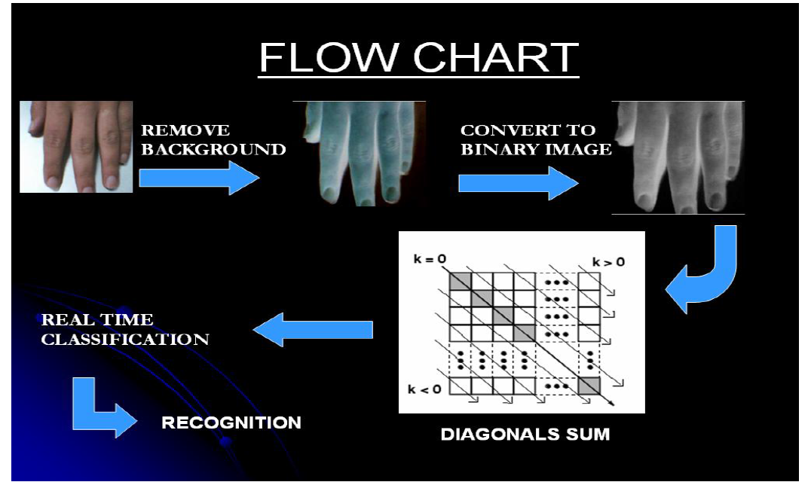
FLOW CHART OF DIAGONAL SUM ALGORITHM

Slide 12
APPLICATION
Hand gestures recognition system has been applied for different applications on different domains, as sign language translation.
Virtual environments, smart surveillance, robot control, medical systems, gaming etc.

Slide 13
THANK YOU

